Slide 1

Capstone Project: Regression Used Car Prediction Ronald Langrin

Slide 2
Contents
Executive Summary
Model Selection
Problem and Solution Summary
Exploratory Data Analysis
Model Building
Recommendations from Implementation

Slide 3
EXECUTIVE Summary
The Models Questions
What is the problem?
Why is it important?
What is the intended goal?
What is the key takeaways and next steps?
From the perspective of a seller, it is not an easy task to set the correct price of a used car, and there in lies the problem
With profitability being the primary goal, the pricing scheme of these used cars becomes important in order to grow in the market.
The goal is to develop an effective pricing model that can accurately predict the price of used cars based upon a series of known attribute's. This pricing model will aid business and sellers in devising profitable strategies.
A dataset is collected and pre-processed. Exploratory data analysis has been performed. Following that, various machine learning regression algorithms, including Linear Regression, Ridge / Lasso Regression, Decision Trees, Random Forest, XGBoost, while noting risks and challenges

Slide 4
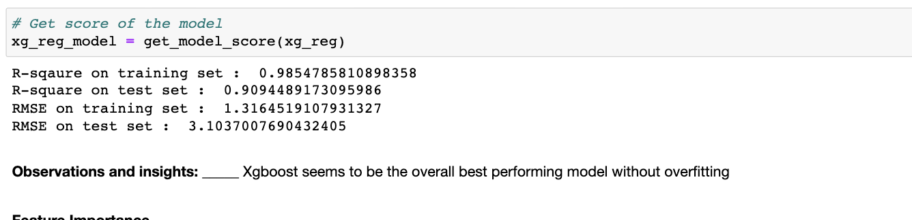
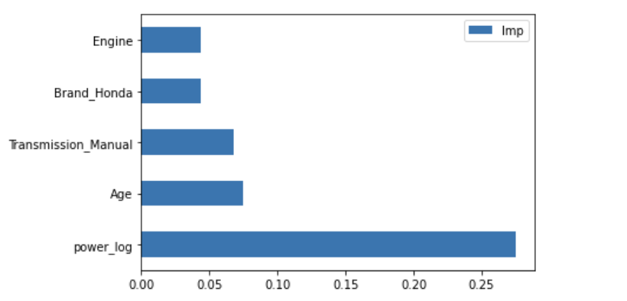
MODEL SELECTION
MoDEL Selection Results:
XGBOOST
Advantages: At the moment it’s the de-facto standard algorithm for getting accurate results from predictive modeling with machine learning. Effective with large data sets. Tree algorithms such as XGBoost and Random Forest do not need normalized features and work well if the data is nonlinear, non-monotonic, or with segregated clusters.
Disadvantages: Tree algorithms such as XGBoost and Random Forest can over-fit the data, especially if the trees are too deep with noisy data.

Slide 5
Problem and Solution Summary
The Key Questions and InFluencers
Why are they selling the car?
How old is the car?
What’s the car’s mileage?
How long have they owned the car?
What is the Brand and Model of the car?
What is the engine and power of the car?
Due to the unprecedented number of cars being purchased and sold, used car price prediction is a topic of high interest. Because of the affordability of used cars in developing countries, people tend more purchase used cars. A primary objective of this project is to estimate used car prices by using attributes that are highly correlated with a label (Price). An effective pricing model that can effectively predict the price of used cars and can help the business in devising profitable strategies using differential pricing.

Slide 6
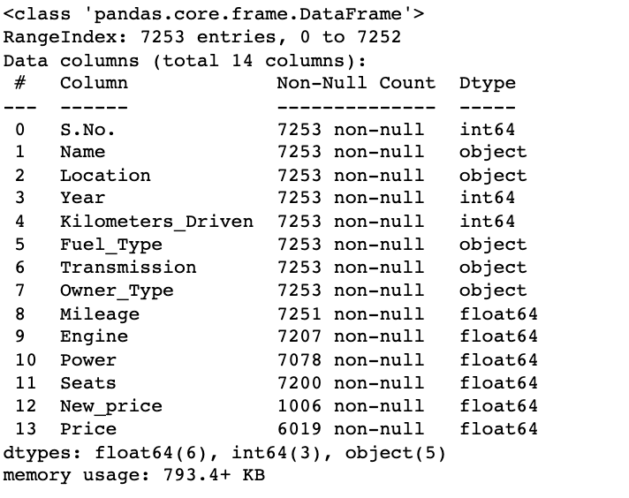
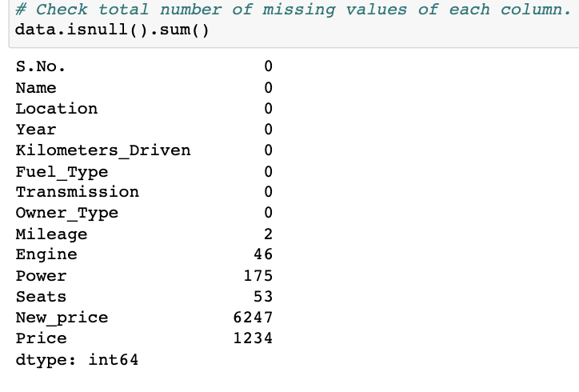
EXPLORATORY DATA ANALYSIS
The Key Takeaways
Understand the data by observing a few rows
Chech the Dataset Size (7253 records)
check the data types and and missing values of each column
Check Kilometers_Driven extreme values
Check Mileage extreme values
Check Price extreme Values
Check Power Extreme Values

Slide 7
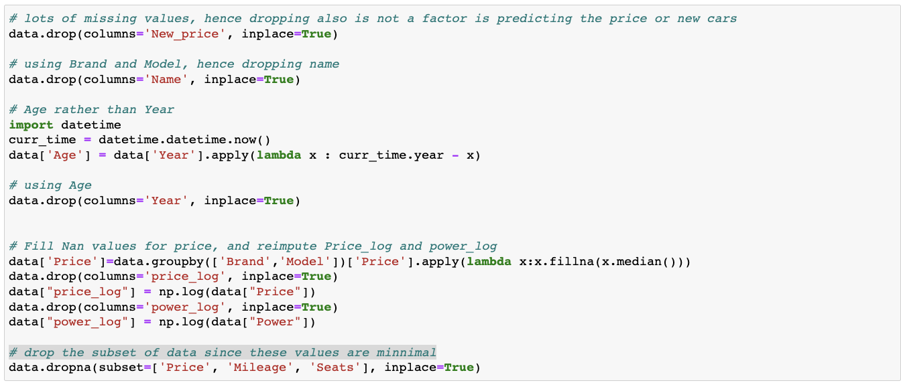
EXPLORATORY DATA ANALYSIS
The Key Takeaways
Handling Missing Values
Handling Highly skewed Data

Slide 8
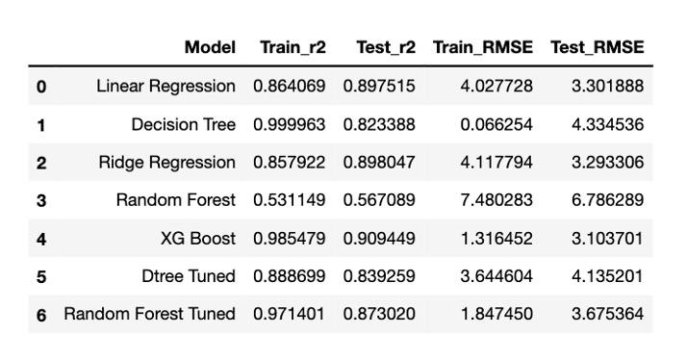
MODEL BUILDING
Models
Linear Regression
Ridge / Lasso Regression
Decision Trees (Hyper Tuned)
Random Forest (Hyper Tuned)
XGBoost
Model Building Sequence
Step1: Seperating the indepdent variables (X) and the dependent variable (y).
Step2: Encode the categorical variables in X using pd.dummies.
Step3: Scale the data using MinMax Scaler.
Step4: Split the data into train and test using train_test_split.

Slide 9
Recommendations frOM Implementation
Take Aways
What are the key actionables for stakeholders?
What is the expected benefit and/or costs?
What are the key risks and challenges?
What further analysis needs to be done or what other associated problems need to be solved?
Our used car Price Prediction Model is intended to aid Used Car Sellers are ensure that they are receiving maximum compensation for their Used Vehicles
Currently our model is able to predict and analyze the value of a Used Car. However, there exists some probalility of error in which a Used Car’s value is incorrectly predicted. This may be as a result of lack of variables in the dataset
The tradeoff between model performance and model interpretability of the XGBoost Regression Model should also be addressed. These improvements will allow for the Model to have a more meaningful impact throughout the business.
Maximizing profit for the stakeholders (refer to the feature selection in the prescribed model). Newer cars, Manual Transmission, Hondas, Engine power/size

Slide 10
Recommendations frOM Implementation cont’d
Take Aways
What are the key actionables for stakeholders?
What is the expected benefit and/or costs?
What are the key risks and challenges?
What further analysis needs to be done or what other associated problems need to be solved?
More sophisticated way to calculate price especially relative to age
More sophisticated way to identify the Model based on the Name column
Taking into account “data leakeage” between test and train data
Power_Log seems to be the most significant variable which would suggest a fabricated dataset
To investigate how well the XGBoost model predicts price of a car, we can collect additional samples
Label encoding the Model variable may be an option however this may prevent an unwanted bias
Exploring Hyper tuning parameters

Slide 11
Works cited
https://towardsdatascience.com/pros-and-cons-of-various-classification-ml-algorithms-3b5bfb3c87d6
https://en.wikipedia.org/wiki/Feature_selection
https://en.wikipedia.org/wiki/Feature_engineering
https://scikit-learn.org/stable/index.html

